Slide 1

SQGA: QUANTUM GENETIC ALGORITHM-BASED WORKFLOW SCHEDULING IN FOG-CLOUD COMPUTING
Raouf Belmahdi
Djamila Mechta
Saad Harous
Abdelhak Bentaleb
Reviewed By
Khalid Redwan Sun
ID - 20301281
Course- CSE449
BRAC University

Slide 2

INTRODUCTION
a)
b)
c)
Fog Computing and its role in Cloud infrastructure
Importance of task scheduling in Fog-Cloud environments.
Importance of task scheduling in Fog-Cloud environments.

Slide 3
Methodology
a)
b)
c)
The components of workflow including tasks, nodes, execution time
problem of workflow task scheduling
foundation for the SQGA algorithm

Slide 4

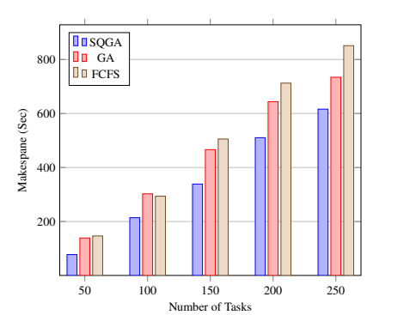
Result
Proposed SQGA scheduling algorithm outperforms both GA and FCFS algorithms by 40%
and 50% in makespan, respectively

Slide 5
Limitations
a)
b)
c)
Scalability of the algorithm
Importance of task scheduling in Fog-Cloud environments.
other quality of service (QoS) metrics should be considered

Slide 6

Conclusions
Key takeaways from the paper
success of the SQGA algorithm in improving scheduling in Fog-Cloud environments.
future directions and potential enhancements for the research

